Slide 1

Sport Club

Slide 2
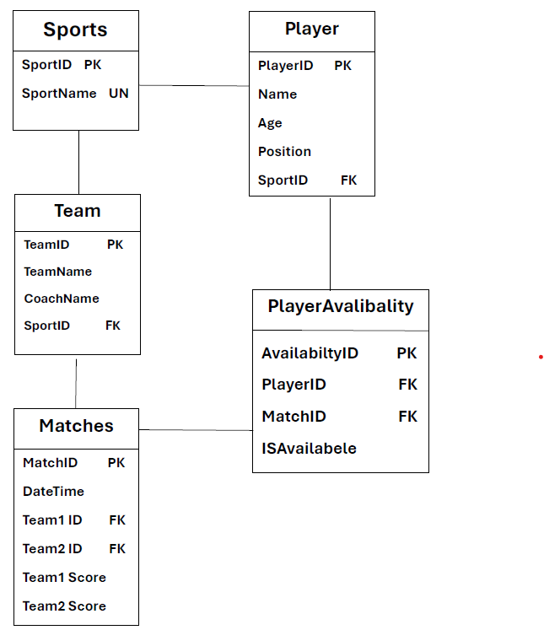
Er Diagram

Slide 3
Introduction
Our SPORTS CLUB is a sports and health club membership management system where you can keep records on your members and have quick and easy communication between you and your members .
SPORTS also includes a booking system and has a range of reports that help in the management of the club.
It enables efficient organization and tracking of player information, team details, match schedules, and player participation across various sports.

Slide 4

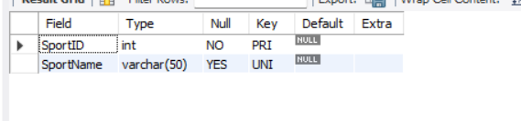
Structure of Table
The Sports table serves as a catalog of sports offered by the sports club.

Slide 5
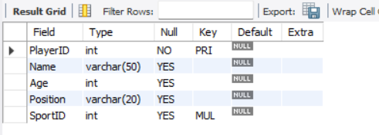
The Players table stores comprehensive information about individual players within the sports club.

Slide 6
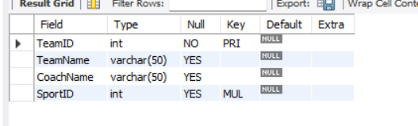
The Teams table organizes data related to sports teams within the sports club.

Slide 7
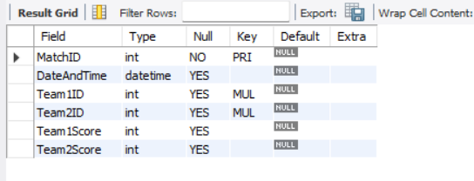
The Matches table captures essential information about scheduled sports matches.

Slide 8
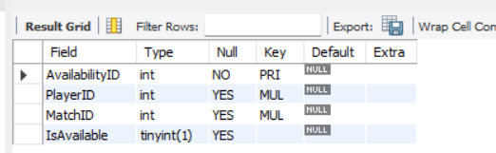
The Player Availability table plays a crucial role in tracking the availability of players for specific matches.

Slide 9
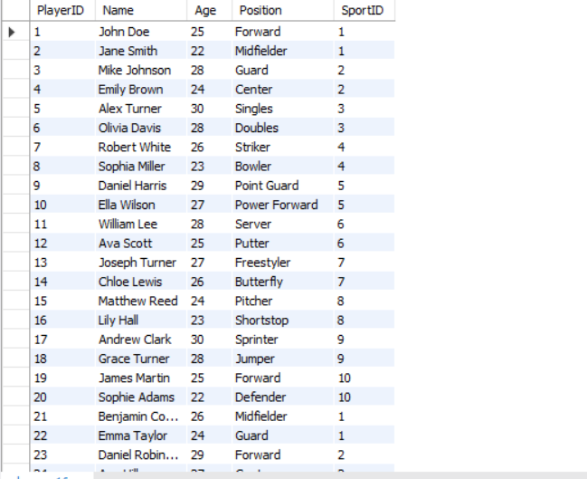
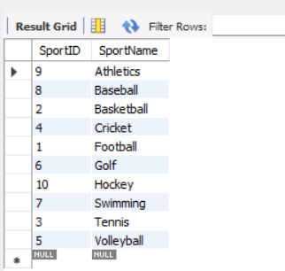
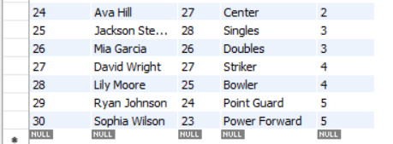
Content of table
Sport Table
Player Table

Slide 10
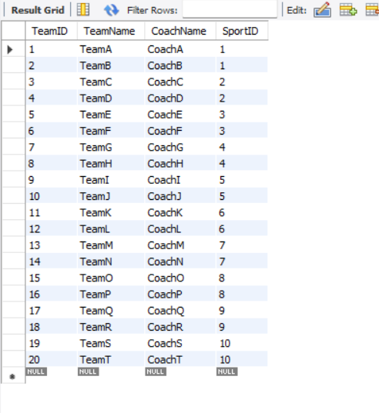
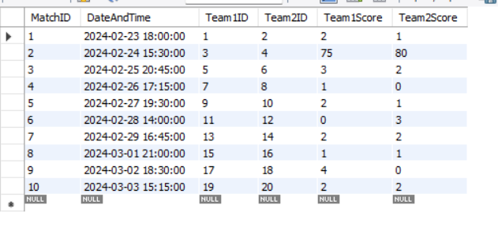
Team Table
Match Table

Slide 11
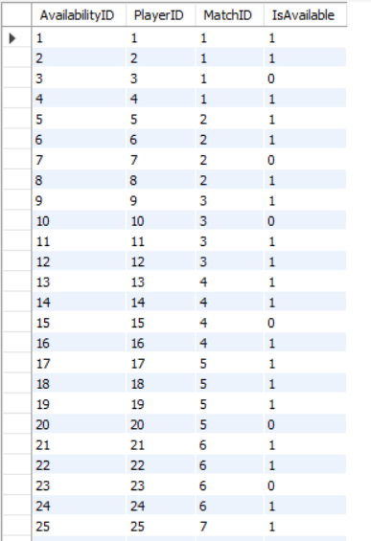
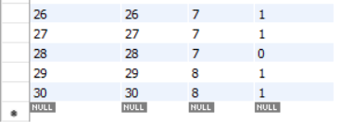
PlayerAvailability Table

Slide 12
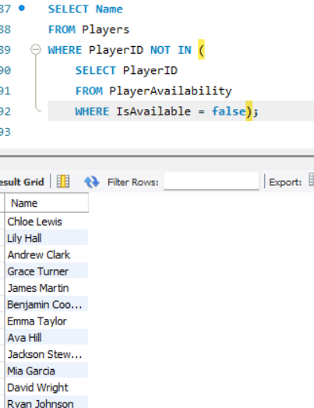
SUB QUERIES
Players Who Have Never Been Unavailable for Any Matches

Slide 13
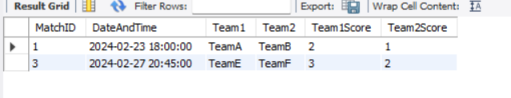
details of matches where a specific team has played.

Slide 14
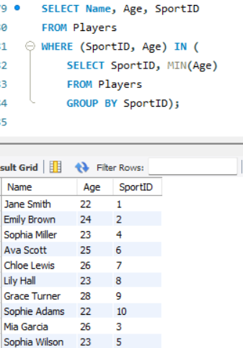
Find the Youngest Player in Each Sport

Slide 15
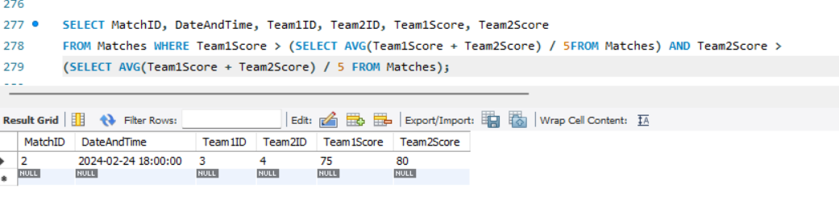
List of Matches Where Both Teams Scored More Than the Average Score

Slide 16
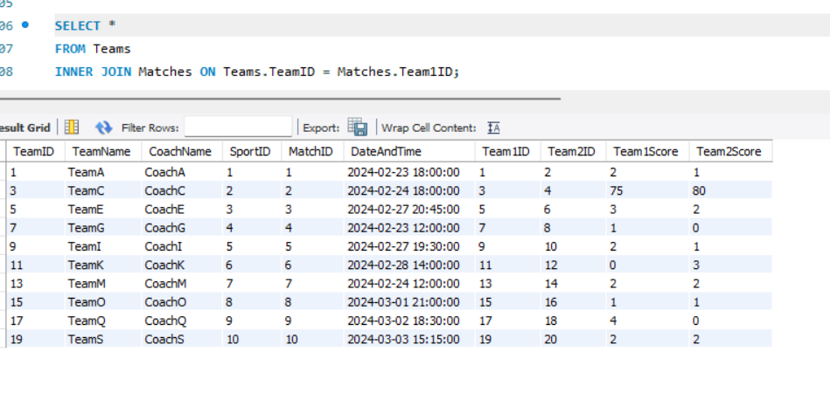
Join
This query retrieves information about teams participating in matches.

Slide 17
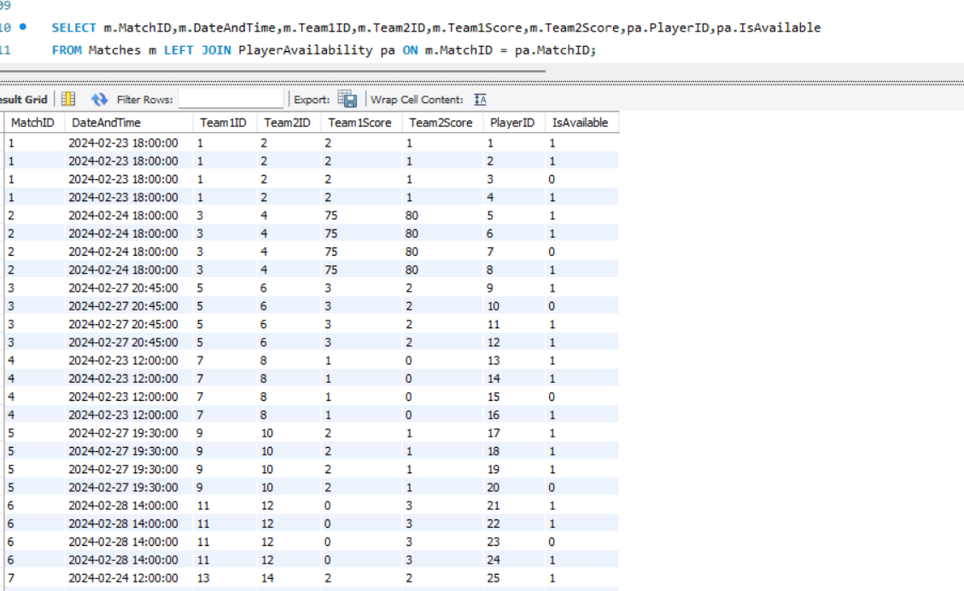
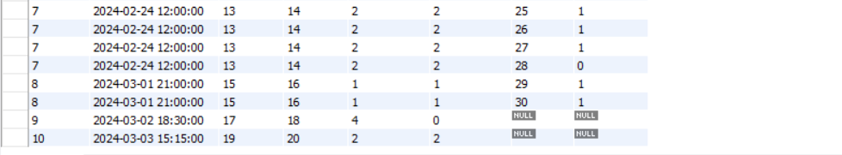
All matches, regardless of whether there are corresponding availability records for each match.

Slide 18
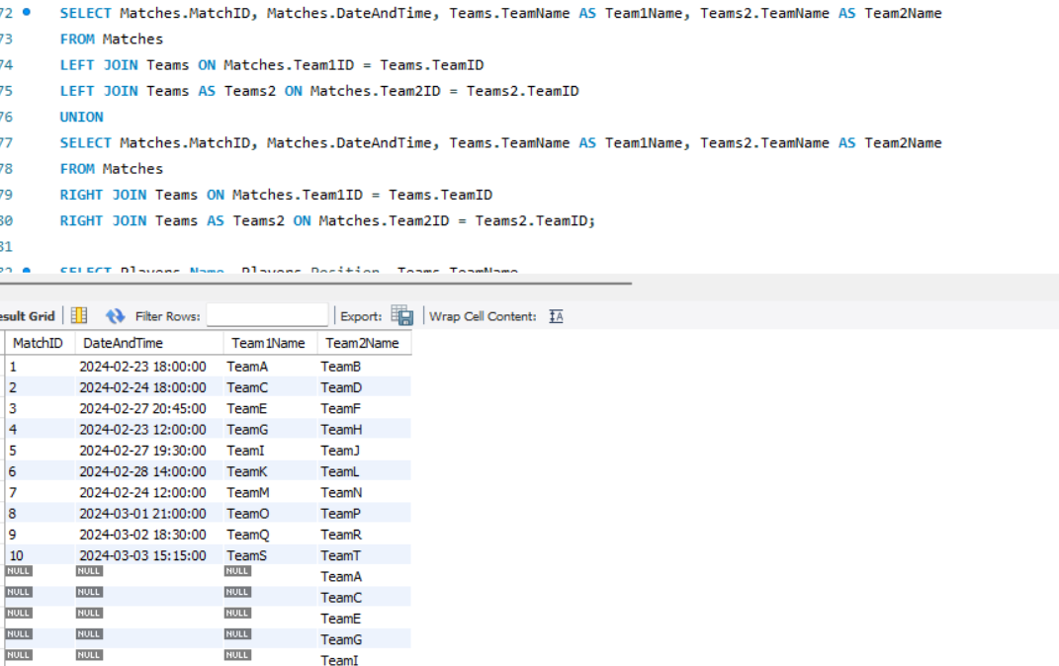
To retrieve match details along with the corresponding team names for both teams involved in each match.

Slide 19
Thank You
Prepared by
Hrithik Pathipaka

